Slide 1
3D Transformation

Slide 2
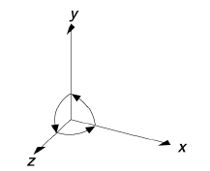
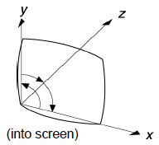
Representation of 3D Transformations
Z axis represents depth
Right Handed System
– When looking “down” at the
origin, positive rotation is CCW
Left Handed System
– When looking “down”, positive
rotation is in CW
– More natural interpretation for
displays, big z means “far”

Slide 3
Basic 3D Transformations
Identity
Scale
Translation
Mirror about Y/Z plane

Slide 4
Basic 3D Transformations
Rotate around Z axis:
Rotate around Y axis:
to maintain the consistency for
+ve rotation we did change in rotation around y axis
Rotate around X axis:

